Slide 1



Office of Risk and Insurance Management (ORIM)
Equipment Maintenance Management Insurance Program
(EMMP)
Insurance Renewal for Coverage Term 6/30/18 – 6/30/19
March 29, 2018

Slide 2
Agenda
Renewal Process
How to Review & Report Changes to your Renewal List
New Process for the EMMP Renewal Form
Payment Options
Important Deadlines
Questions??

Slide 3
Renewal Process
Recently you were emailed your Renewal List(s)
By April 27, 2018
Confirmed Renewal Lists
Any changes must be returned to EMMP@dgs.ca.gov
(cc CA.EMMP@theremigroup.com)
By May 11, 2018
2018/2019 All Renewal Invoices will be distributed
June 30, 2018
Payment for Renewal Invoices Due

Slide 4
Reviewing and Reporting Changes to the Renewal List
Due by April 27, 2018
Changes will be effective on June 30, 2018

Slide 5
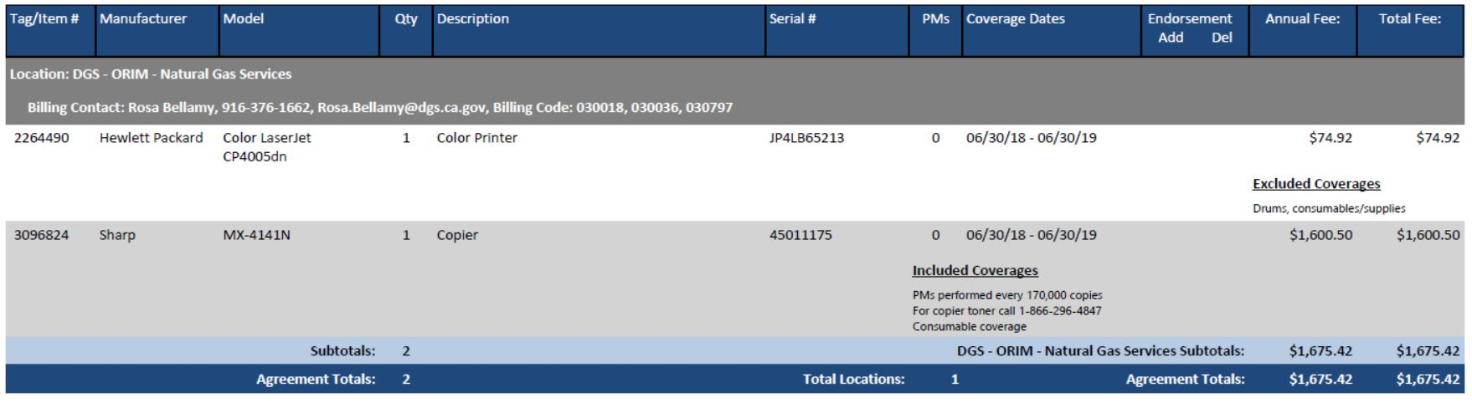
Reviewing Your Renewal List

Slide 6
New Process for the
EMMP Renewal Form
The EMMP Renewal Form is no longer required:
“EMMP coverage on listed equipment will remain in effect until removed or non‐renewed.”
What Does this Mean for your Department?:
  The 2017/18 Renewal Form and subsequent Quote Enrollment forms are the official document accepting the EMMP Coverage and the T&C’s.
  EMMP will reuse this form and will not require additional signatures.
  For the period EMMP coverage is in effect, premium will be earned on enrolled equipment and due by owning department.

Slide 7
To Add Equipment, please contact EMMP@dgs.ca.gov
Additions of Equipment will be processed through
a separate Quote, Quote Enrollment Form, and Invoice

Slide 8
All Renewal List Changes are Due by April 27, 2018
All changes to your Renewal lists that are submitted prior to April 27th will be processed and reflect on your Renewal Invoices distributed on May 11, 2018
Payment of Alliant Renewal Invoices are Due on
June 30, 2018

Slide 9
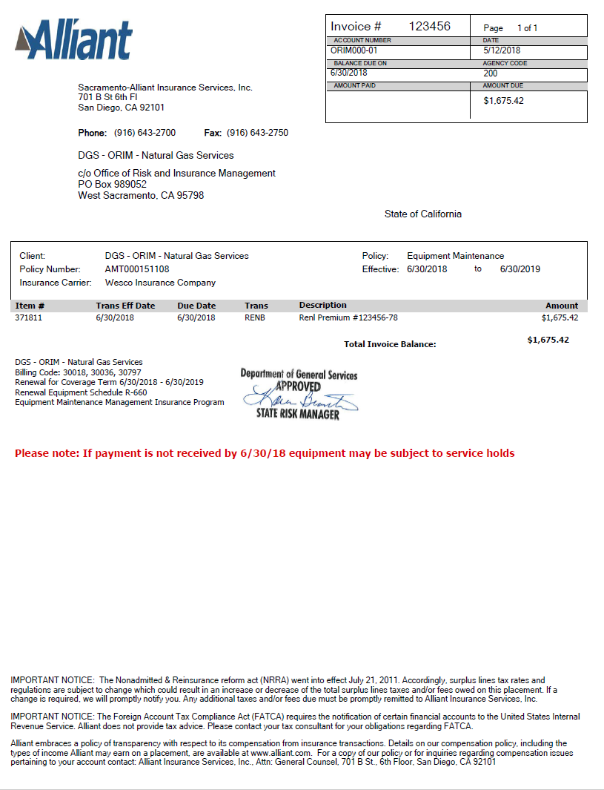
Alliant Invoice

Slide 10
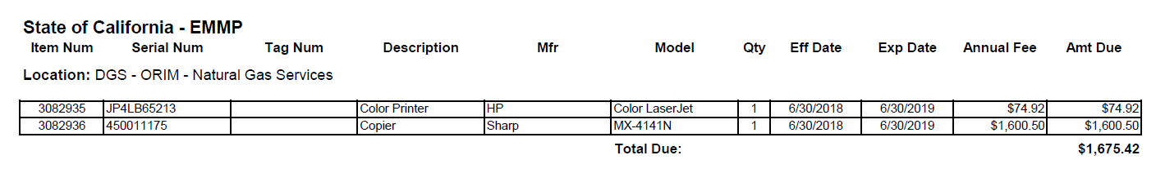
Equipment information
6/30/2018 | 6/30/2019
6/30/2018 | 6/30/2019

Slide 11
2018/2019 Renewal Invoices
Renewal Invoices will be delivered via email by May 11, 2018
Payment of the Renewal Invoices is due no later than June 30, 2018
- Late payments may result in covered equipment being subject to Service Holds

Slide 12
Payment Options
Per the California State Controllers Office (SCO):
Any Alliant invoice, for any amount, can be submitted to SCO for “straight payment”, without an approved PO/SO, by any State department as long as the Alliant invoice has been “approved for payment” (Stamped and signed by the appropriate Office of Risk and Insurance Management (ORIM) representative.)

Slide 13
Important Deadlines
By March 30, 2018
  Renewal List(s) emailed to each Location
April 27, 2018
  Changes to Renewal Lists are Due
After April 27, 2018
  Changes to Renewal Lists will be handled by a separate Invoice
May 11, 2018
  Renewal Invoices will be distributed via email
June 30, 2018
  Payment of Alliant Renewal Invoices are Due
July 1, 2018
  Late payments may result in covered equipment being subject to Service Holds

Slide 14
Questions?
QUESTIONS??

Slide 15


For More Information
Visit us online: http://www.dgs.ca.gov/orim/Programs/Insurance.aspx
ORIM’s EMMP Mailbox:
EMMP@dgs.ca.gov
Jessica Carpenter
Assistant Risk Analyst
916-617-3620
jessica.carpenter@dgs.ca.gov
Darren Miyata
Assistant Risk Analyst
916-376-1621
darren.miyata@dgs.ca.gov
Carrie Willson
Staff Risk Manager
916-376-5278
carrie.willson@dgs.ca.gov
REMI’s EMMP Mailbox:
CA.EMMP@theremigroup.com
Jason Mann
Account Executive
916-216-9984
jmann@theremigroup.com
Sean Rood
Customer Assistance Specialist
916-376-3684
sean.rood@theremigroup.com
Mimi Hocking
Customer Assistance Specialist
916-441-9697
maureen.hocking@theremigroup.com

